Slide 1
Statistics for Managers
Using Microsoft® Excel
5th Edition
Chapter 7 (Textbook Ch9)
Fundamentals of Hypothesis Testing: One-Sample Tests

Slide 2
Chapter Goals
After completing this chapter, you should be able to:
Formulate null and alternative hypotheses for
testing the population mean or proportion
Formulate a decision rule for testing a hypothesis
Know how to use the critical value and p-value to test
the null hypothesis
Know what Type I and Type II errors are

Slide 3

What is a Hypothesis?
A hypothesis is a claim
(assumption) about a
population parameter:
  population mean
  population proportion
Example: The mean monthly cell phone bill of this city is μ = $42
Example: The proportion of adults in this city with cell phones is p = .68

Slide 4
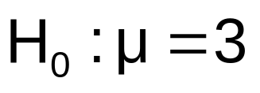

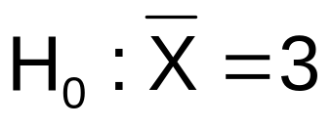
The Null Hypothesis, H₀
States the assumption (numerical) to be tested
  Example: The average number of TV sets in U.S. Homes is equal to three ( )
Is always about a population parameter, not about a sample statistic

Slide 5

The Null Hypothesis, H₀
(continued)
Begin with the assumption that the null
hypothesis is true
  Similar to the notion of innocent until
  proven guilty
Refers to the status quo
Always contains “=” , “≤” or “≥” sign
May or may not be rejected

Slide 6
The Alternative Hypothesis, H₁
Is the opposite of the null hypothesis
  e.g., The average number of TV sets in U.S.
  homes is not equal to 3 ( H₁: μ ≠ 3 )
Challenges the status quo
Never contains the “=” , “≤” or “≥” sign
May or may not be proven
Is generally the hypothesis that the
researcher is trying to prove

Slide 7
Hypothesis Testing Process
Claim: the
population
mean age is 50.
(Null Hypothesis:
Population
H₀: μ = 50 )
Now select a random sample
Is
X
=
20
likely if μ = 50?
If not likely,
Suppose
the sample
REJECT
mean age
is 20: X = 20
Sample
Null Hypothesis

Slide 8
Reason for Rejecting H₀
Sampling Distribution of X
X
20
μ = 50
If H₀ is true
... then we reject the null hypothesis that μ = 50.
If it is unlikely that we would get a sample mean of this value ...
... if in fact this were
the population mean…

Slide 9
Level of Significance, α
Defines the unlikely values of the sample
statistic if the null hypothesis is true
  Defines rejection region of the sampling distribution
Is designated by α , (level of significance)
  Typical values are .01, .05, or .10
Is selected by the researcher at the beginning
Provides the critical value(s) of the test

Slide 10
Level of Significance and the Rejection Region
Level of significance =
α
Represents
critical value
H₀: μ = 3 H₁: μ ≠ 3
α
α
/2
/2
Rejection region is shaded
Two-tail test
0
H₀: μ ≤ 3 H₁: μ > 3
α
Upper-tail test
0
H₀: μ ≥ 3 H₁: μ < 3
α
Lower-tail test
0

Slide 11
Errors in Making Decisions
Type I Error
  Reject a true null hypothesis
  Considered a serious type of error
  The probability of Type I Error is α
    Called level of significance of the test
    Set by researcher in advance

Slide 12
Errors in Making Decisions
(continued)
Type II Error
  Fail to reject a false null hypothesis
  The probability of Type II Error is β

Slide 13
Outcomes and Probabilities
Possible Hypothesis Test Outcomes
Actual Situation
Decision
H₀ True
H₀ False
Do Not
No error
(1 - )
Type II Error
( β )
Reject
Key:
Outcome
(Probability)
α
H
0
Reject
Type I Error
( )
No Error
( 1 - β )
H
α
0

Slide 14
Type I & II Error Relationship
Type I and Type II errors can not happen at
the same time
  Type I error can only occur if H₀ is true
  Type II error can only occur if H₀ is false
If Type I error probability ( α ) , then
Type II error probability ( β )

Slide 15
Factors Affecting Type II Error
All else equal,
  β when the difference between hypothesized parameter and its true value
  β when α
  β when σ
  β when n

Slide 16
Hypothesis Tests for the Mean
Hypothesis
Tests for 
⬧ Known
⬧ Unknown

Slide 17
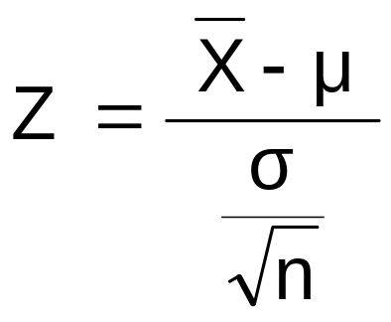
Z Test of Hypothesis for the Mean (σ Known)
Convert sample statistic ( ) to a Z test statistic
X
Hypothesis
Tests for 
σ Known
σ Unknown
The test statistic is:

Slide 18

Critical Value
Approach to Testing
For two tailed test for the mean, σ known:
Convert sample statistic ( ) to test statistic (Z statistic)
Determine the critical Z values for a specified
level of significance α from a table or computer
Decision Rule: If the test statistic falls in the rejection region, reject H₀; otherwise do not reject H₀

Slide 19
Two-Tail Tests
H₀: μ = 3 H₁: μ ≠ 3
There are two
cutoff values
(critical values),
defining the
regions of
rejection
α/2
α/2
3
X
Reject H₀
Do not reject H₀
Reject H₀
-Z
+Z
Z
0
Lower critical value
Upper critical value

Slide 20
Review: 10 Steps in Hypothesis Testing
1. State the null hypothesis, H₀
2. State the alternative hypotheses, H₁
3. Choose the level of significance, α
4. Choose the sample size, n
5. Determine the appropriate test statistic to use
6. Find critical values and determine rejection region(s)
7. Collect data and compute the test statistic
8. Compare test statistic to critical value to determine
whether the test statistic falls in the region of rejection
9. Make statistical decision: Reject H₀ if test statistic falls in
rejection region
10. Express the decision in the context of the problem

Slide 21
Hypothesis Testing Example
Test the claim that the true mean # of TV sets in US homes is equal to 3.
(Assume σ = 0.8)
1-2. State the appropriate null and alternative
hypotheses
  H₀: μ = 3 H₁: μ ≠ 3 (This is a two tailed test)
3. Specify the desired level of significance
  Suppose that α = .05 is chosen for this test
4. Choose a sample size
  Suppose a sample of size n = 100 is selected

Slide 22
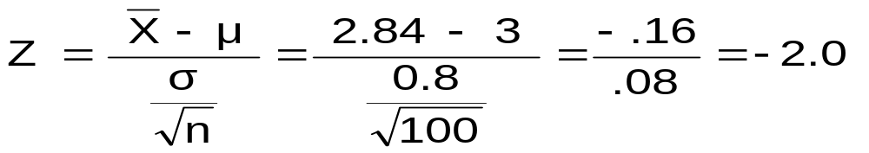
Hypothesis Testing Example
(continued)
5. Determine the appropriate technique
  σ is known so this is a Z test
6. Set up the critical values
  For α = .05 the critical Z values are ±1.96
7. Collect the data and compute the test statistic
  Suppose the sample results are
  n = 100, X = 2.84 (σ = 0.8 is assumed known)
  So the test statistic is:

Slide 23
Hypothesis Testing Example
(continued)
8. Is the test statistic in the rejection region?
α = .05/2
α = .05/2
Reject H₀ if Z < -1.96 or Z > 1.96; otherwise do not reject H₀
Reject H₀
Do not reject H₀
Reject H₀
-Z= -1.96
0
+Z= +1.96
Here, Z = -2.0 < -1.96, so the test statistic is in the rejection region

Slide 24
Hypothesis Testing Example
(continued)
9-10. Reach a decision and interpret the result
 α = .05/2
α = .05/2
Reject H₀
Do not reject H₀
Reject H₀
-Z= -1.96
0
+Z= +1.96
-2.0
Since Z = -2.0 < -1.96, we reject the null hypothesis and conclude that there is sufficient evidence that the mean number of TVs in US homes is not equal to 3

Slide 25
p-Value Approach to Testing
p-value: Probability of obtaining a test statistic more extreme ( ≤ or ≥ ) than the observed sample value given H₀ is true
  Also called observed level of significance
  Smallest value of α for which H₀ can be rejected

Slide 26
p-Value Approach to Testing
(continued)
Convert Sample Statistic (e.g., ) to Test Statistic (e.g., Z statistic )
Obtain the p-value from a table or computer
Compare the p-value with α
  If p-value < α , reject H₀
  If p-value ≥ α , do not reject H₀
X

Slide 27
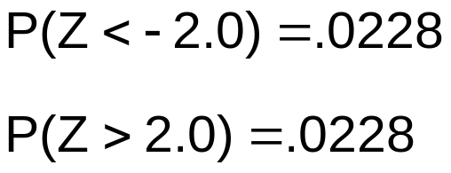
p-Value Example
Example: How likely is it to see a sample mean of 2.84 (or something further from the mean, in either direction) if the true mean is μ = 3.0?
X = 2.84 is translated to a Z score of Z = -2.0
α/2 = .025
α/2 = .025
.0228
.0228
p-value
=.0228 + .0228 = .0456
-1.96
0
1.96
Z
-2.0
2.0

Slide 28
p-Value Example
(continued)
Compare the p-value with α
  If p-value < α , reject H₀
  If p-value ≥ α , do not reject H₀
Here: p-value = .0456
α = .05
Since .0456 < .05, we reject the null hypothesis
α/2 =.025
α/2 = .025
.0228
.0228
-1.96
0
1.96
Z
-2.0
2.0

Slide 29
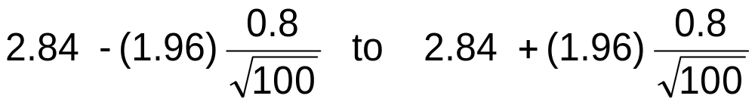
Connection to Confidence Intervals
For X = 2.84, σ = 0.8 and n = 100, the 95%
confidence interval is:
2.6832 ≤ μ ≤ 2.9968
Since this interval does not contain the hypothesized
mean (3.0), we reject the null hypothesis at α = .05

Slide 30
One-Tail Tests
In many cases, the alternative hypothesis
focuses on a particular direction
This is a lower-tail test since the alternative hypothesis is focused on the lower tail below the mean of 3
H₀: μ ≥ 3
H₁: μ < 3
H₀: μ ≤ 3
H₁: μ > 3
This is an upper-tail test since the alternative hypothesis is focused on the upper tail above the mean of 3

Slide 31
Lower-Tail Tests
H₀: μ ≥ 3
H₁: μ < 3
There is only one critical value, since the rejection area is in only one tail
α
Reject H₀
Do not reject H₀
Z
-Z
0
μ
X
Critical value

Slide 32
Upper-Tail Tests
H₀: μ ≤ 3
H₁: μ > 3
There is only one critical value, since the rejection area is in only one tail
α
Z
Do not reject H₀
Reject H₀
0
Z_{α}
X
μ
Critical value

Slide 33
Example: Upper-Tail Z Test for Mean (σ Known)
A phone industry manager thinks that customer monthly cell phone bill have increased, and now average over $52 per month. The company wishes to test this claim. (Assume σ = 10 is known)
Form hypothesis test:
H₀: μ ≤ 52 the average is not over $52 per month
H₁: μ > 52 the average is greater than $52 per month
(i.e., sufficient evidence exists to support the
manager’s claim)

Slide 34
Example: Find Rejection Region
(continued)
Suppose that α = .10 is chosen for this test
Find the rejection region:
Reject H₀
α = .10
Do not reject H₀
Reject H₀
0
1.28
Reject H₀ if Z > 1.28

Slide 35
Review:
One-Tail Critical Value
Standard Normal Distribution Table (Portion)
What is Z given α = 0.10?
.90
.10
.08
Z
.07
.09
α = .10
1.1
.8790
.8810
.8830
.90
1.2
.8980
.8997
.9015
z
0
1.28
1.3
.9147
.9162
.9177
Critical Value
= 1.28

Slide 36
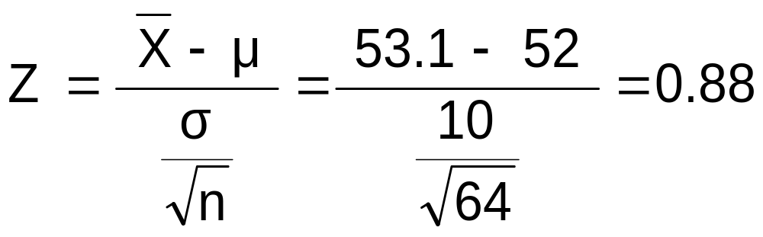
Example: Test Statistic
(continued)
Obtain sample and compute the test statistic
Suppose a sample is taken with the following results: n = 64, X = 53.1 (σ = 10 was assumed known)
  Then the test statistic is:

Slide 37
Example: Decision
(continued)
Reach a decision and interpret the result:
Reject H₀
α = .10
Do not reject H₀
1.28
Reject H₀
0
Z = .88
Do not reject H₀ since Z = 0.88 ≤ 1.28
i.e.: there is not sufficient evidence that the
mean bill is over $52

Slide 38
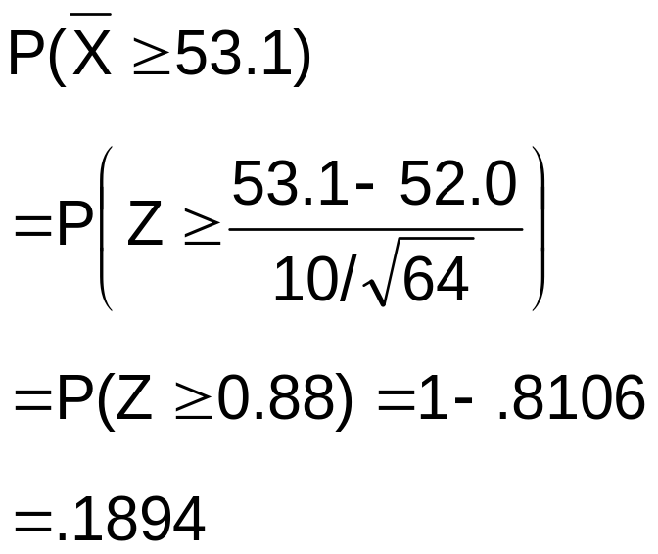
p -Value Solution
(continued)
Calculate the p-value and compare to α
(assuming that μ = 52.0)
p-value = .1894
Reject H₀
α = .10
0
Do not reject H₀
1.28
Reject H₀
Z = .88
Do not reject H₀ since p-value = .1894 > α = .10

Slide 39
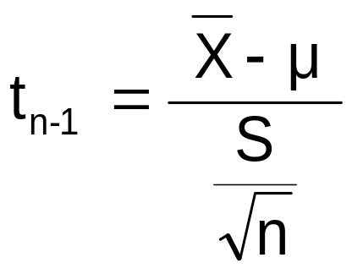
t Test of Hypothesis for the Mean (σ Unknown)
Convert sample statistic ( ) to a t test statistic
X
Hypothesis
Tests for 
σ Known
σ Unknown
The test statistic is:

Slide 40


Example: Two-Tail Test
(σ Unknown)
The average cost of a hotel room in New York is said to be $168 per night. A random sample of 25 hotels resulted in X = $172.50 and
S = $15.40. Test at the
α = 0.05 level.
(Assume the population distribution is normal)
H₀: μ = 168 H₁: μ 168

Slide 41
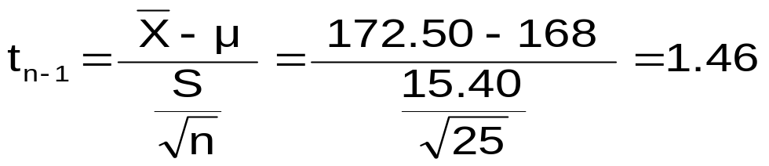
Example Solution:
Two-Tail Test
H₀: μ = 168 H₁: μ 168
α/2=.025
α/2=.025
α = 0.05
n = 25
σ is unknown, so
use a t statistic
Critical Value:
t₂₄ = ± 2.0639
Reject H₀
Do not reject H₀
Reject H₀
-t _{n-1,α/2}
t _{n-1,α/2}
0
-2.0639
2.0639
1.46
Do not reject H₀: not sufficient evidence that true mean cost is different from $168

Slide 42


Connection to Confidence Intervals
For X = 172.5, S = 15.40 and n = 25, the 95%
confidence interval is:
172.5 - (2.0639) 15.4/ 25 to 172.5 + (2.0639) 15.4/ 25
166.14 ≤ μ ≤ 178.86
Since this interval contains the Hypothesized mean (168),
we do not reject the null hypothesis at α = .05

Slide 43
Hypothesis Tests for Proportions
Involves categorical variables
Two possible outcomes
  “Success” (possesses a certain characteristic)
  “Failure” (does not possesses that characteristic)
Fraction or proportion of the population in the “success” category is denoted by p

Slide 44
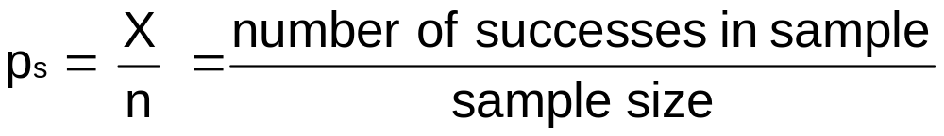
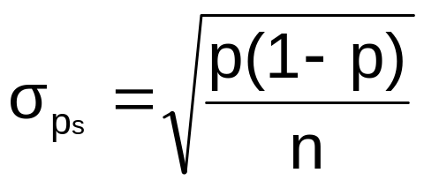
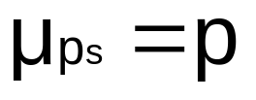
Proportions
(continued)
Sample proportion in the success category is
denoted by p_{s}
When both np and n(1-p) are at least 5, p_{s} can be approximated by a normal distribution with mean and standard deviation

Slide 45
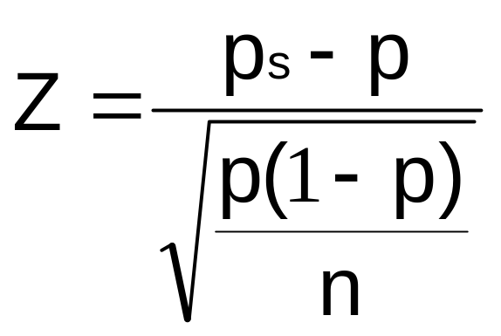
Hypothesis Tests for Proportions
The sampling distribution of p_{s} is approximately normal, so the test statistic is a Z value:
Hypothesis
Tests for p
np ≥ 5
and
n(1-p) ≥ 5
np < 5
or
n(1-p) < 5
Not discussed in this chapter

Slide 46
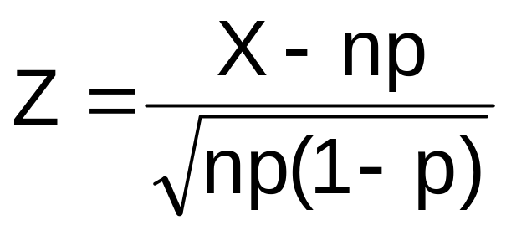
Z Test for Proportion in Terms of Number of Successes
An equivalent form to the last slide, but in terms of the number of successes, X:
Hypothesis
Tests for X
X ≥ 5
and
n-X ≥ 5
X < 5
or
n-X < 5
Not discussed in this chapter

Slide 47

Example: Z Test for Proportion
A marketing company claims that it receives 8% responses from its mailing. To test this claim, a random sample of 500 were surveyed with 25 responses.
Test at the α = .05 significance level.
Check:
n p = (500)(.08) = 40
n(1-p) = (500)(.92) = 460

Slide 48
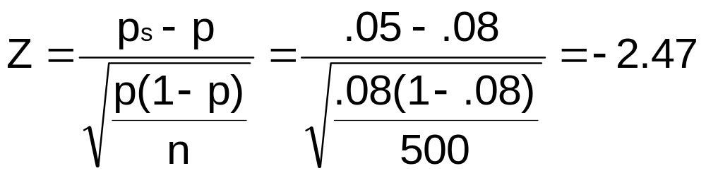
Z Test for Proportion: Solution
Test Statistic:
H₀: p = .08 H₁: p ≠ .08
α = .05
n = 500, p_{s} = .05
Critical Values: ± 1.96
Decision:
Reject H₀ at α = .05
Reject
Reject
Conclusion:
α =.025
α = .025
There is sufficient evidence to reject the company’s claim of 8% response rate.
z
-1.96
0
1.96
-2.47

Slide 49
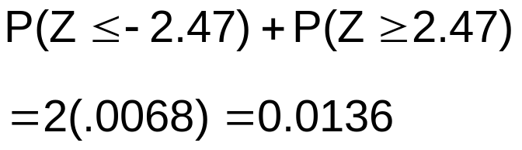
p-Value Solution
(continued)
Calculate the p-value and compare to α
(For a two sided test the p-value is always two sided)
Do not reject H₀
Reject H₀
Reject H₀
p-value = .0136:
α/2 = .025
α/2 = .025
.0068
.0068
-1.96
0
1.96
Z = -2.47
Z = 2.47
Reject H₀ since p-value = .0136 < α = .05

Slide 50
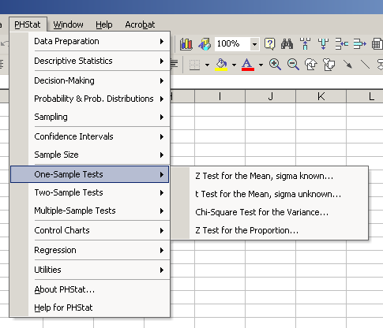
Using PHStat
Options

Slide 51
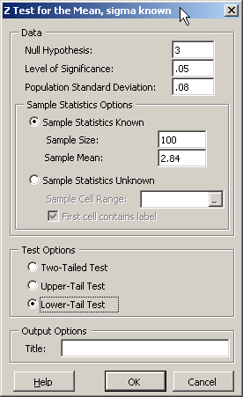
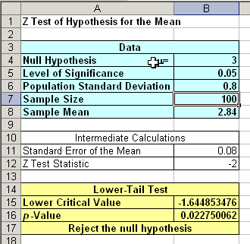
Sample PHStat Output
Input
Output

Slide 52
Chapter Summary
Addressed hypothesis testing methodology
Performed Z Test for the mean (σ known)
Discussed critical value and p–value approaches to hypothesis testing
Performed one-tail and two-tail tests
Performed t test for the mean (σ unknown)
Performed Z test for the proportion
(End of Chapter 7)

